Slide 1

Fundamentals - III

Slide 2
Recap...
Variables are non-persistent data storage
Can be numbers, text, containers and more.
Python variables are weakly typed
Arithmetic operators are used for numeric calculation
Addition (+), subtraction (-), multiplication (*), division (/), power(**), modulo (%) etc.
Boolean operators are used for comparison and logic calculation
Examples of comparison operators: Equality (==), inequality (!=), greater than (>), less than (<) etc.
Examples of logical operators: and, not, or, in etc.

Slide 3
Recap...
Conditionals help in branching decisions
Loops are used for repetitive tasks
Examples of loops are for and while
continue and break statements are loop modifiers
if something: Do this else: Do that

Slide 4
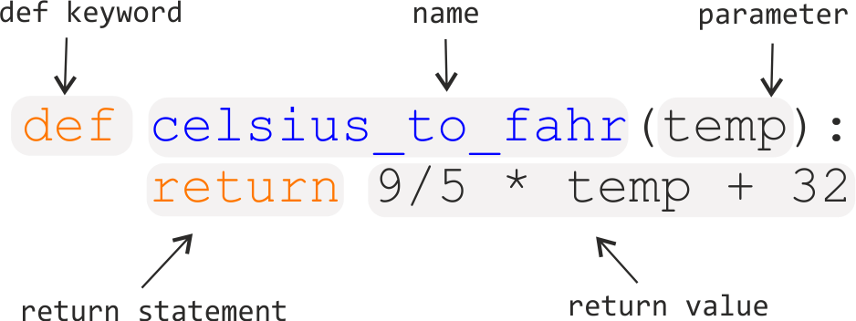
Recap...
Functions are modular code-blocks for a specific purpose

Slide 5




Recap...
Modules and packages
Modules are simply python files other than the calling file
Packages are folders containing python modules
Import statements are used to fetch modules and packages in the current program
How can i use import?
How can i use import?
OR
How to use math functions now
How to use math functions now

Slide 6
File Handling
Open/Create files
Use file = Open(“filename.txt”, “r”) to open a file
“r” here means Read. “w” for Write and “a” for Append also works
If the file doesn’t exist, opening it in “w” mode will create the file
Close file
Always close an opened file, otherwise written data can be lost
file.close() - closes the file

Slide 7
File Handling
Read from file
file.read() - reads the whole file and returns it as a string
file.read(5) - reads first 5 characters and returns it as a string
file.readline()- reads one line of the file and returns it
Write to File
file.write(“Hello world!”) - write a string to the file

Slide 8
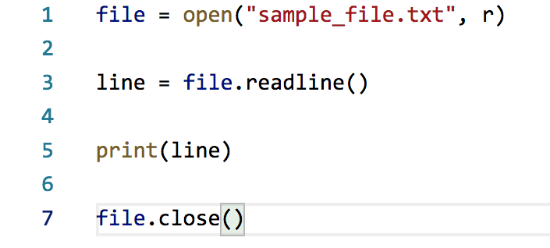
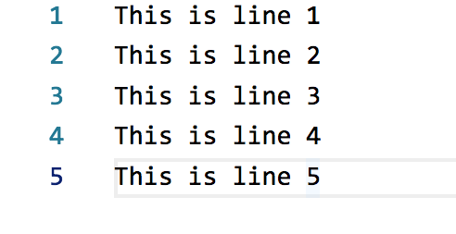
File Handling
sample_file.txt
file_handling.py
Output> This is line 1

Slide 9
File Handling
Filenames can either be relative of absolute
Relative filenames are relative to the calling python file
Absolute filenames contain the entire file-path e.g. c:\some-folder\some-file.txt
file.readline() reads a file and goes to the next line
Calling file.readline() second time returns the second line
file.write() overwrites any previous information in the file
Adding a “+” after “r” or “w” allows both read and write (e.g. “r+”, “w+”)

Slide 10
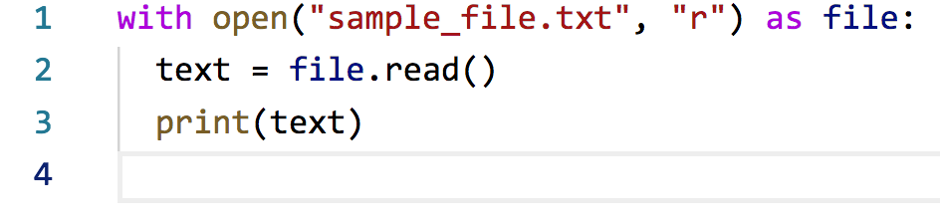
With statement
If an operation requires pre-work (e.g. opening) and post-work (e.g. closing)

Slide 11
Errors
Syntax error
Wrong code. E.g. a = 1+2 3 4
Compilation error
Also wrong code, but more subtle (e.g. printing a variable that is not defined)
Runtime error
Errors that happen when the code is run
Sometimes not the fault of the programmer (e.g. user enters text when number is asked)
Errors, when anticipated can be stopped before it stops the code

Slide 12
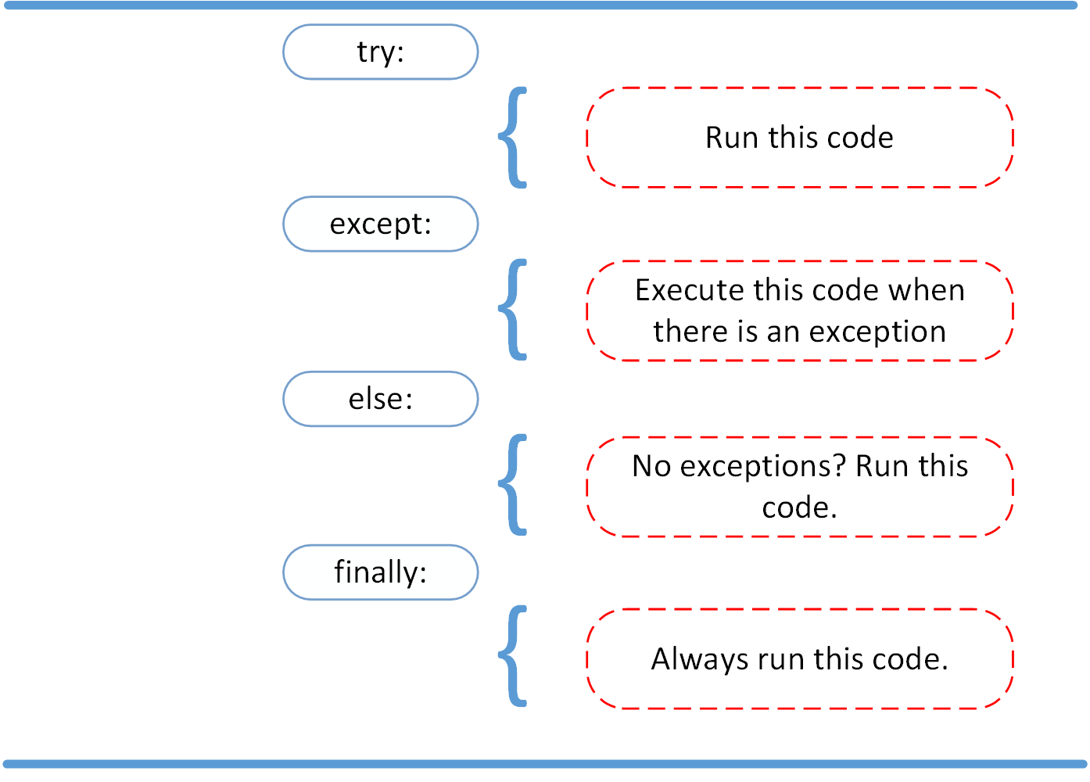
Try...except
An error, until it stops the program is called an Exception
Exceptions can be created by an user if necessary
Exceptions can be stopped using try...except blocks.
else and finally blocks are optional but useful

Slide 13
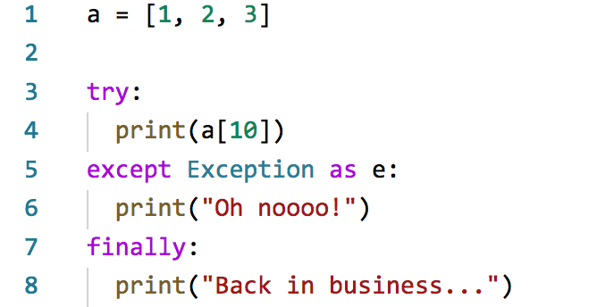
Try...except
List a only has 3 elements
Program stops execution and comes here
Program resumes again (optional)

Slide 14
Debugging
To remove errors from your code
To inspect your code
One of the most important part of software development
More or less like this:

